Slide 1
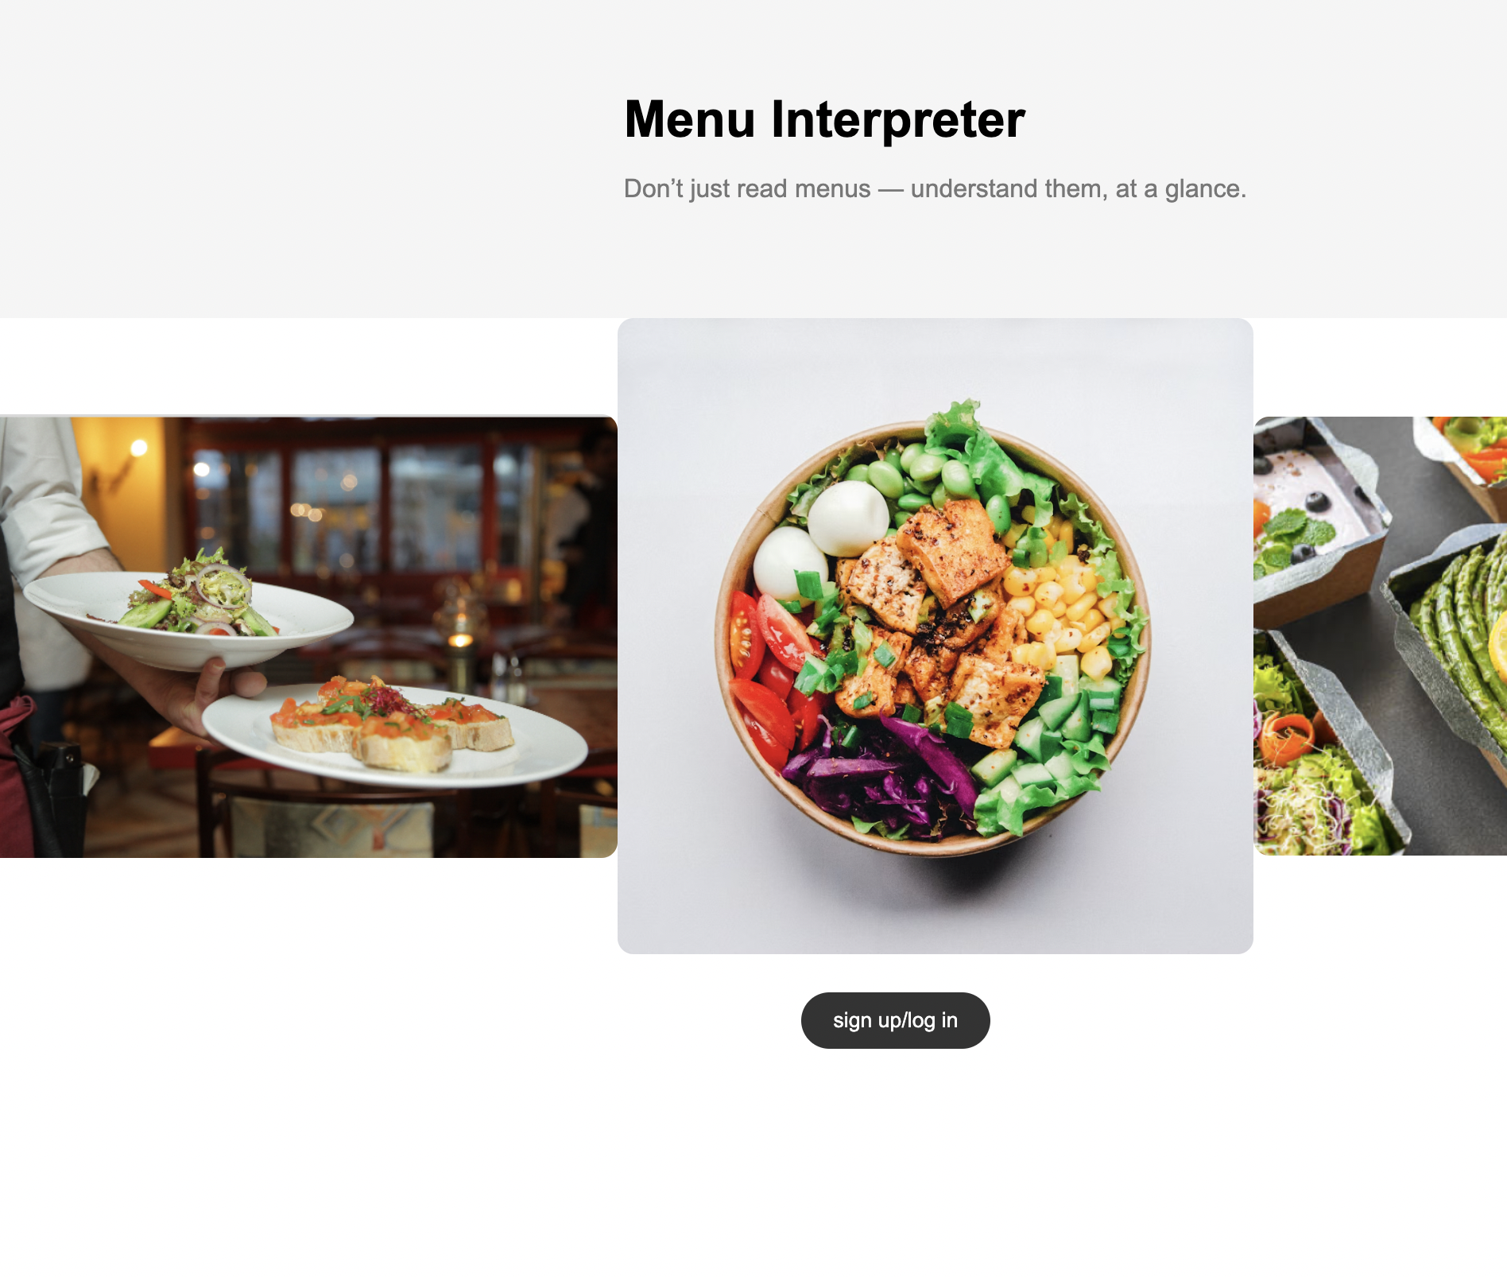
Menu Interpreter
Karen Wang, Ruoyu Chen, Rohan Rabbi, Bonny Quan

Slide 2
The Problem
Modern dining experiences are increasingly characterized by the diversity of dietary preferences, health considerations, and individual tastes. Traditional menus often lack the granularity required to cater to unique dietary restrictions, leading to a tedious and time-consuming process of deciphering suitable options.
Our research is motivated by the need to bridge the gap between generic menus and specific nutritional requirements, and it strives to enable consumers to make informed decisions effortlessly. The proposed tool employs cutting-edge technologies, including menu APIs, Optical Character Recognition (OCR) techniques such as AWS textract, and natural language processing (NLP).

Slide 3
Target audience:
People with special dietary restrictions due to health condition or religion,
People with personal preferences or nutrition goals
People who don’t want to spend time reading long menus when ordering food
People who want help picking restaurants that provides the dishes they like

Slide 4
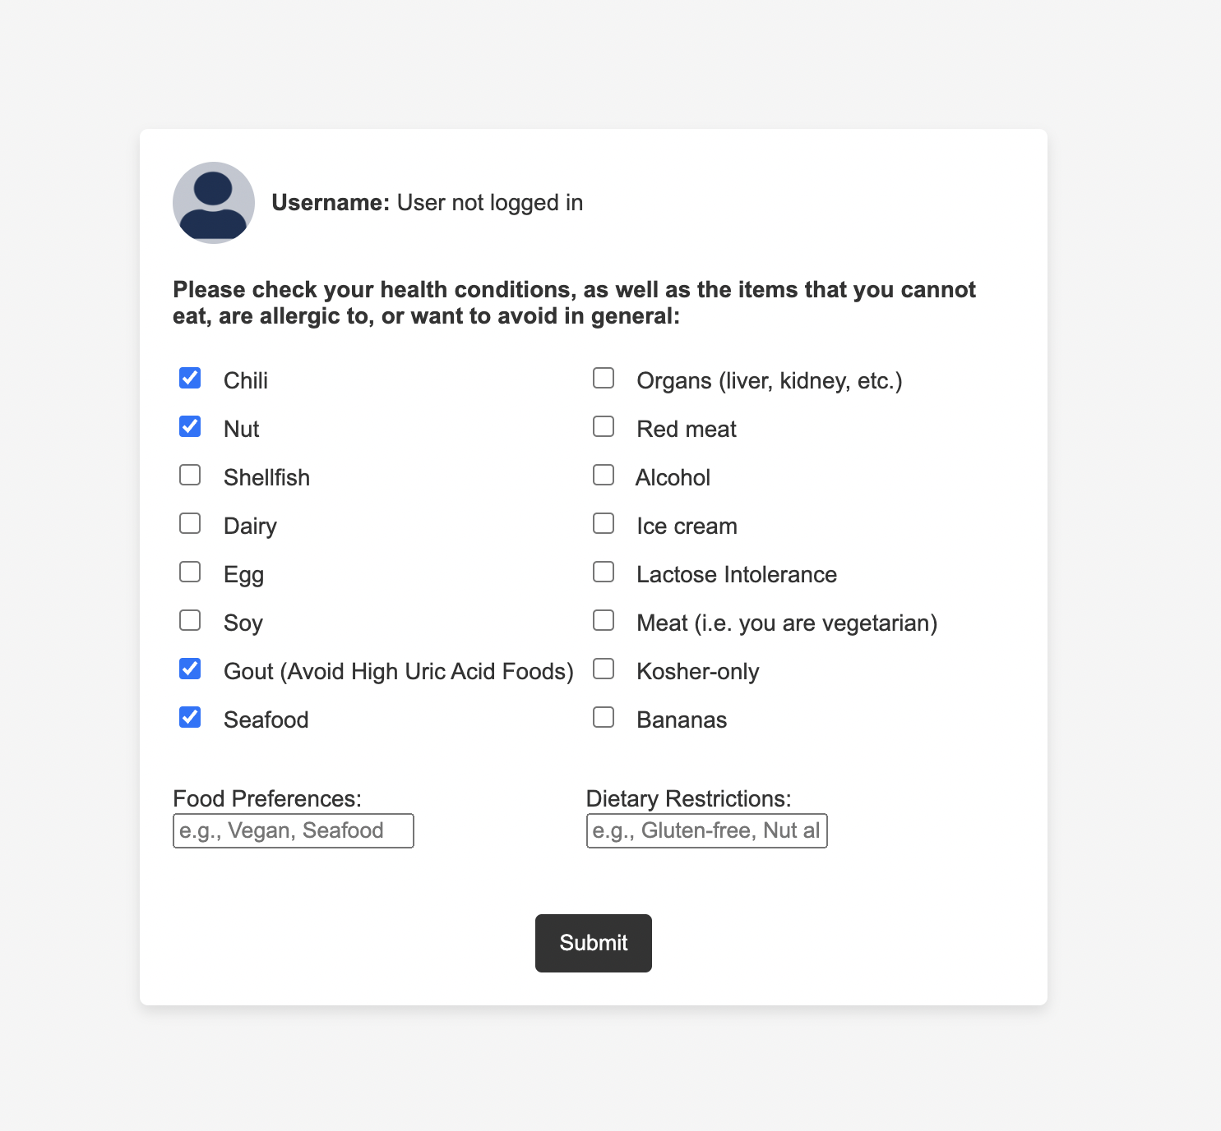
The Idea
We built a tool that processes food menus, synthesizes information and provides a summary matching the overall collection of dishes to the users’ personal needs, including allergy history, nutrition needs, diet restrictions, religion, diet preferences, etc.

Slide 5
The technicals
AWS Textract for extracting text on menu images;
OpenAI API for analyzing menu text and generating report based on user preferences;
Opensearch for restaurant/menu data for easier search, dynamoDB for user data management.
key components of our app:

Slide 6
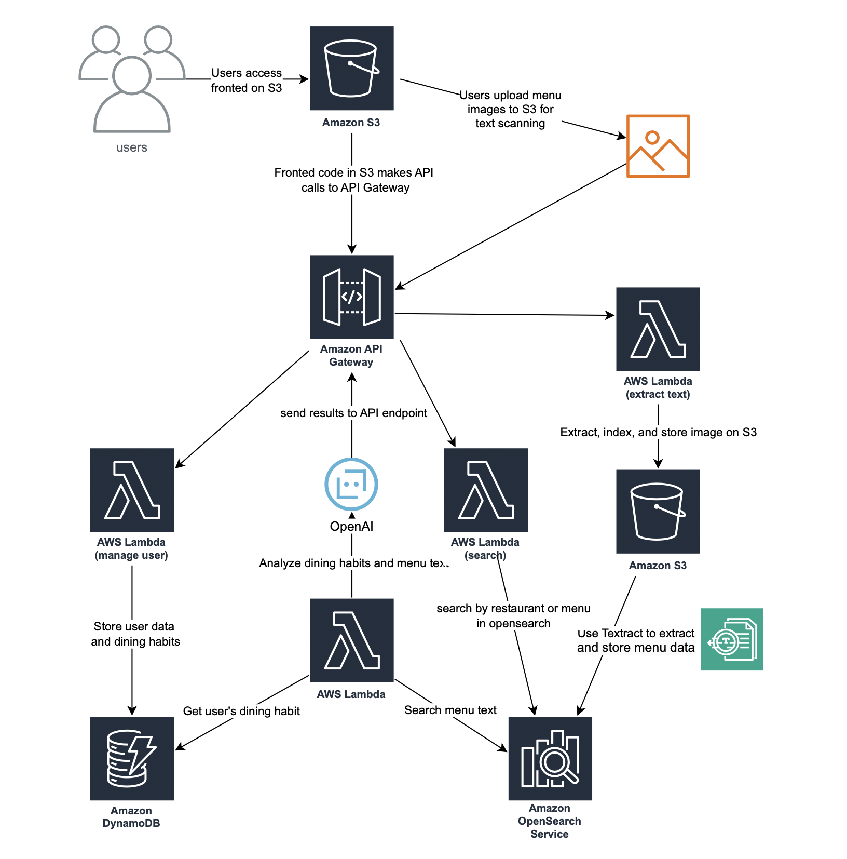
System Architecture

Slide 7
Conclusion and Future Implications
Effective Personalization: The project successfully developed a system that personalizes restaurant menu recommendations based on individual dietary needs, integrating OCR, NLP, and AWS services. This has significantly improved the dining experience for users with specific dietary restrictions.
Technological Integration: The project expertly integrates several AWS technologies to create a robust and scalable solution. Each of these technologies is carefully orchestrated to handle specific aspects of real-time menu processing and user data management, demonstrating a sophisticated and efficient technological ecosystem.

Slide 8

Thank you!
Try it yourself here: http://menu-interpreter-frontend.s3-website-us-east-1.amazonaws.com/

